Slide 1

Two-dimensional Convolutional Neural Network Using Quantitative US for Noninvasive Assessment of Hepatic Steatosis in NAFLD
Radiology 2023
結合B-mode、TAI參數圖、TSI參數圖預測USFF

Slide 2
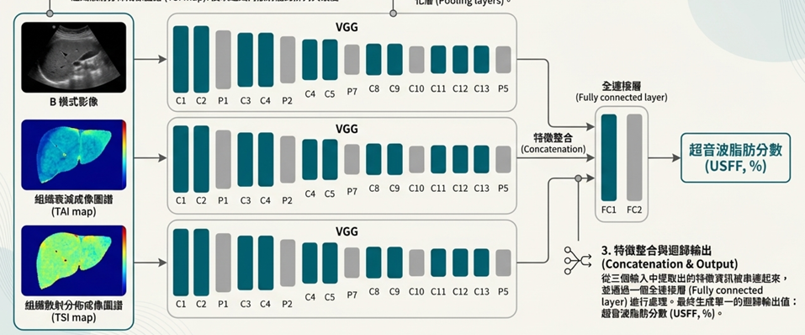
使用的input image
B-mode 240×320 扇形
TAI參數圖 90×256 正方形(示意圖)
TSI參數圖90×256 正方形
(示意圖)
B-mode、TAI、TSI都是由原始射頻數據（Raw Frequency data）建立而成
B-mode 影像：經過掃描轉換，輸入為「扇形」影像
TAI和 TSI參數圖是基於Raw Frequency data計算出來的定量參數，不轉換為扇形，直接以矩陣(90×256)輸入

Slide 3
使用的input image
B-mode 240×320 扇形
TAI參數圖 90×256 正方形(示意圖)
TSI參數圖90×256 正方形
(示意圖)
B-mode、TAI、TSI都是由原始射頻數據（Raw Frequency data）建立而成
The TAI and TSI maps were inputted as square images before scan conversion to a convex shape, but the B-mode input was used as a convex shape image to preserve the shape and brightness information of the liver.

Slide 4
測量方法和原因
使用QUS(TAI、TSI)的原因
multivariable logistic regression model using various QUS parameters has yielded high diagnostic accuracy for hepatic steatosis(脂肪肝).
QUS parametric maps derived from radiofrequency data analysis can provide more information about liver tissue composition, which can be lost during B-mode image generation.
B-mode image depicts different tissue characteristics.
測量方法
醫師在測量時會避開大血管，但「全圖」輸入意味著視野內的小血管或周邊結構仍會被保留在影像中。
這有助於 CNN 模型像放射科醫師一樣，透過整體的超音波衰減模式（例如深部訊號變黑的程度）來判斷脂肪肝的嚴重程度，而不僅僅是看局部紋理。
(the B-mode input was used as a convex shape image to preserve the shape and
brightness information of the liver. )

Slide 5
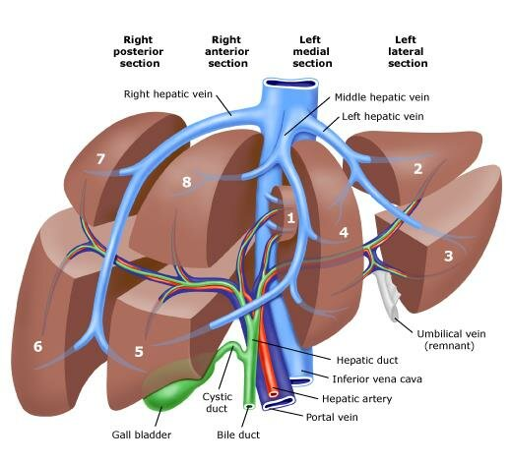
Label: MRI-PDFF
和醫院的做法相同:
Manually placed a 1-cm-diameter circular region of interest
in each of the nine Couinaud liver segments of the PDFF map.
Averaged values from liver segment five through eight were
calculated and used as the reference hepatic fat content value
to match the USFF and QUS data that were obtained from the
right hepatic lobe.

Slide 6
Model
使用VGG:
共216個病人
對每一個輸入（TAI、TSI、B-mode）分別使用獨立的 VGG 網絡分支來提取特徵資訊，然後將這三組特徵串接起來，最後通過全連接層得出回歸輸出。
optimizer用SGD、learning rate為0.000001、loss function為MSE、batch size 32；訓練1500個epoch。

Slide 7
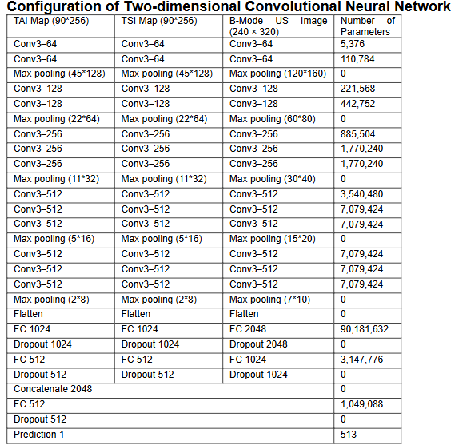
Model
使用VGG:

Slide 8
Performance
比較:
TAI、TSI、B-mode都用
只用TAI、TSI
醫師肉眼判斷
得出前者較好(前者跟PDFF的差距較小)
Correlation between USFF and MRI PDFF:
USFF 和 MRI-PDFF 相關係數 0.86，95%信心水準真實值落在0.82 ~ 0.90之間，R^2為0.74
AUC:
The USFF AUCs for evaluating hepatic steatosis based on MRI PDFF values
PDFF value | >= 5% | >= 15% | >= 15%
AUC | 0.97 | 0.96 | 0.95

Slide 9
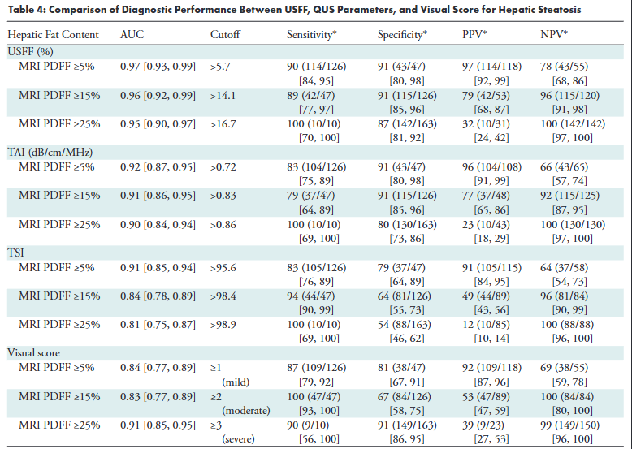
Performance
比較:
TAI、TSI、B-mode都用
只用TAI、TSI
醫師肉眼判斷
得出前者較好(前者跟PDFF的差距較小)
用Youden index來決定s0,s1,s2,s3對應的USFF區間

Slide 10
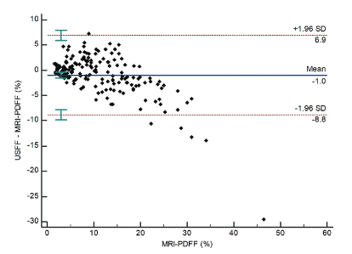
Performance
回歸數值差距:
The mean bias of the USFF over the entire MRI PDFF range was −0.97% (P = .002),
95% 的測量誤差範圍落在 -8.8% 至 6.9% 之間

Slide 11
Performance
Upside:
higher sensitivity(真陽性率) of the USFF than that of the visual score may be more helpful in screening patients with clinically
Downside:
不管用甚麼方法(TAI、TSI、Bmode、醫生判斷)， s3類(MRI PDFF ≥25%)的陽性預測值都很差，作者認為這是因為在嚴重脂肪肝區域中，訊號已經嚴重衰減，已經不靈敏了，因此不好判斷。

